Slide 1
Options Strategy Recommendation
and Optimization System
An explainable options analysis and search pipeline
Tey Hao Teck / Group 3
Intelligent Reasoning Systems Practice Module
A0362588M

Slide 2
Options give buyers a right
to buy or sell an asset
CALL
PUT
Right to buy
Right to sell
A purchased call benefits from a rise
in the underlying price, all else equal.
A purchased put benefits from a fall
in the underlying price, all else equal.
Strike = agreed price Expiry = contract end Premium = option price
Example: buy a $100 call for $5. At expiry, a $110 share price
gives $10 intrinsic value and $5 profit per share before fees.

Slide 3
Existing platforms help traders
compare options strategies
OptionStrat
OptionsPlay
Visual strategy builder
Potential profit and loss
Volatility and time-decay effects
Strategy recommendations
Probability and risk analysis
Profit-and-loss projections
This project’s focus
An academic prototype with inspectable reasoning,
explicit payoff assumptions and testable genetic search.

Slide 4
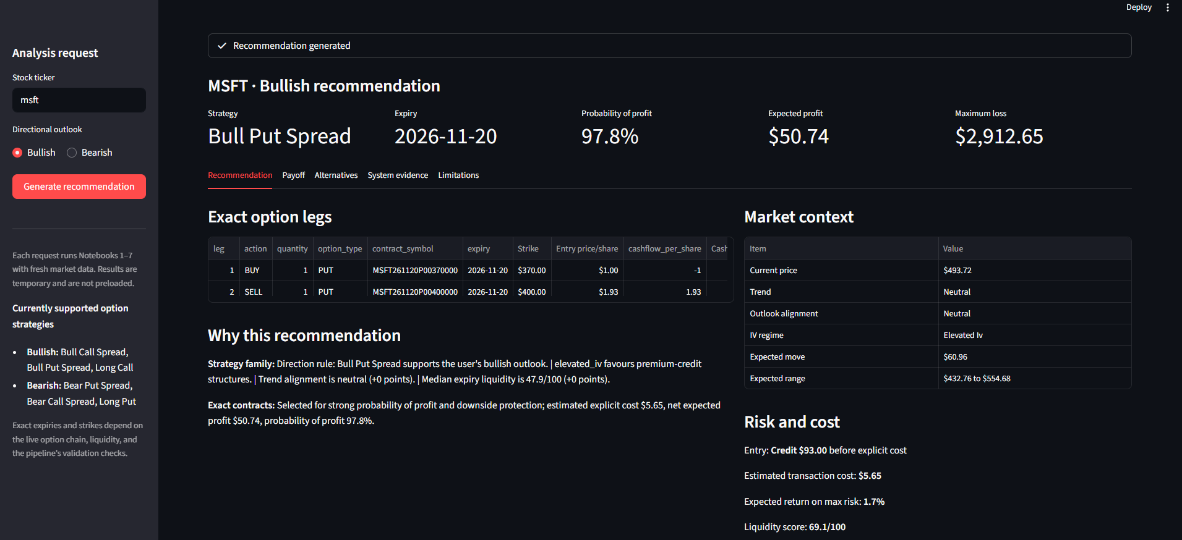
A market outlook still leaves
many trade choices
Input
Output
Ticker + outlook
Explainable trade and risk estimates

Slide 5
Six strategy families cover
two user outlooks
Bullish | Bearish
Bull Call Spread | Bear Put Spread
Bull Put Spread | Bear Call Spread
Long Call | Long Put
One ticker per request. Decision support without trade execution.

Slide 6
Seven analysis stages feed
the Streamlit application
1 Collect data
2 Build features
3 Apply rules
and graph
4 Evaluate payoffs
Streamlit result
7 Validate payload
6 Evaluate results
5 Genetic search
Runtime: Notebooks 1–7. Application generation is separate from each analysis request.

Slide 7
Established methods support
reasoning and search
Knowledge graph
Monte Carlo
Genetic algorithm
Represents strategy
relationships
Estimates payoff
uncertainty
Searches contract
combinations
Contribution: one traceable decision-support pipeline

Slide 8

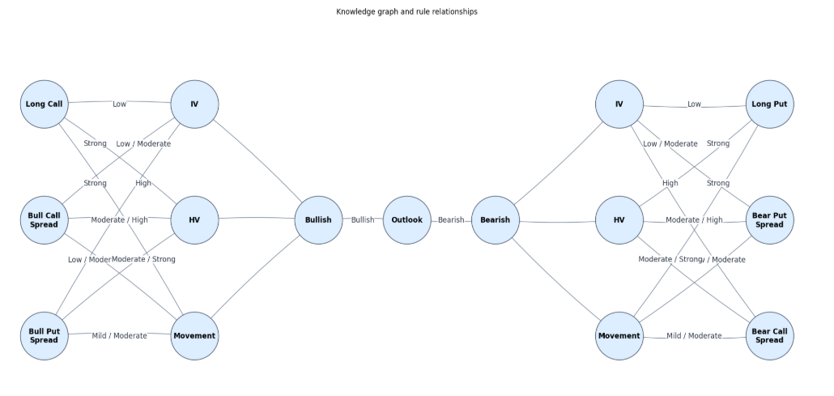
Domain knowledge connects outlook to strategy families
04

Slide 9
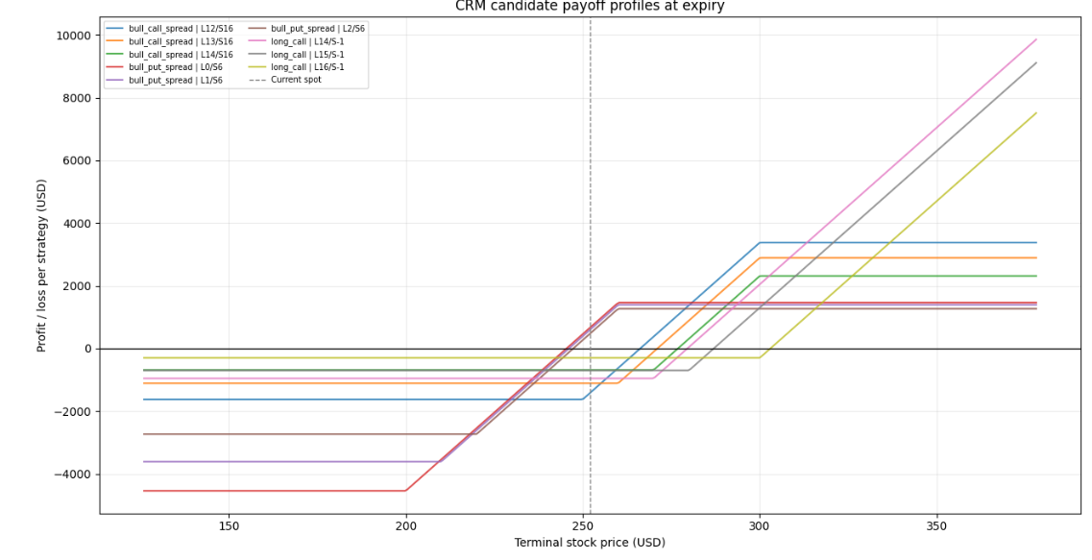
Monte Carlo to estimate payoffs uncertainty

Slide 10
Genetic search balances
six competing objectives
Strategy
Expiry
Long strike
Short strike
Fitness component | Weight | Fitness component | Weight
Net return on risk | 30% | Capital efficiency | 10%
Profit probability | 20% | Liquidity | 15%
Downside protection | 15% | Rule alignment | 10%

Slide 11
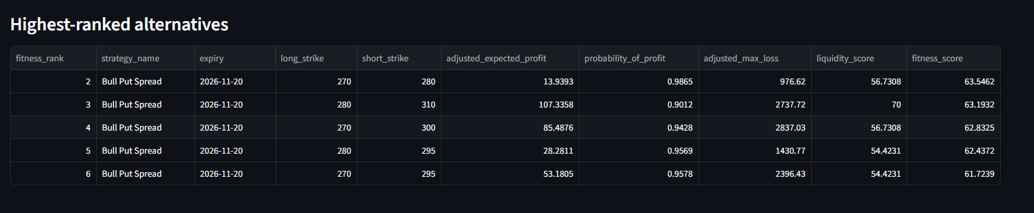
Normalization converts unlike measures into a 0–100 score
s = [clip(x, P5, P95) − P5] / (P95 − P5)
Reverse with 1 − s when lower is better
Fitness = 100 × Σ(weight × normalised score)
06

Slide 12
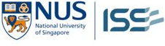
Backtesting the recommendations
Proposed evaluation using historical option data
Historical test
Main metric
1. Generate
Average realised return on risk
Use only data available on each test date.
2. Simulate entry
Per trade: net profit or loss after costs
÷ maximum risk at entry × 100%
Use historical option quotes and costs.
3. Calculate outcome
Measure net profit or loss at expiry.
Supporting evidence
4. Repeat and compare
Win rate and number of trades
Improvement over the rule-only baseline
Test GA and rule-only methods on the
same dates, outlooks and expiry horizons.
12

